Slide 1

LOGO
About Us
Join Us
Contests & Blog
Individuals & Families
Business Owners
Turning 65+
Planning & Guidance
Sub-items listed in notes.
Search
Site Search
Our Strategic Partners
Receive a $25 Restaurant.com gift card when you enroll online.
LOGO
LOGO
LOGO
LOGO
LOGO
LOGO
LOGO
LOGO
LOGO
LOGO
LOGO
LOGO
Speak to a Professional
Text a Professional
Schedule an Appointment
Banner: Life is Precious.
Affordable
Case Study
Value
Case Study
Video 1
Video 2
Risk
Case Study
Value
Case Study
Video 3
Video 4
Request a Call
Michael Gonzales, Owner
Air Force Veteran
BRAIN FART…..HELP ME FILL THIS SPACE!
LOGO
Client Testimonies
Social Media Links
Facebook, LinkedIn, Twitter, Instagram
Notes:
Individuals & Families:
Speak to a Professional
Life Insurance
Vision Insurance
Dental Insurance
Health Insurance
Deductible Insurance
Disability Insurance
Mortgage Protection
Accident only policies
Critical Illness policies
Cancer, Heart & Stroke policies
Business Owners:
Speak to a Professional
Group Benefits
Life Insurance
Vision Insurance
Health Insurance
Dental Insurance
Accident Insurance
Disability Insurance
Succession Planning
Buy/Sell Agreement
Key Employee Insurance
Retirement Services (401k)
Critical Illness Insurance
Paid Family Medical Leave
Turning 65+:
Speak to a Professional
Know YOUR Options
Enrollment Assistance
Medicare Supplements
Medicare Advantage Plans
Special Dates to Remember
Work From Home Opportunities
Schedule an Appointment
Planning & Guidance
I want to…
Lower my bills
Protect my business
Medical Travel Insurance
Improve my health & wellness
Find Affordable Health Insurance
Speak to a Medicare Professional
Know how to prepare for retirement
Understand how Life Insurance works
Understand how Long-Term Care works
Understand how Short-Term Care works
Understand how Disability Insurance works
See if I qualify for Private Medical Insurance
About Us: (will be a stand-alone link)
Join Us:
Become a Referral Partner
Become a Business Associate
Become a Licensed Insurance Broker
Contests & Blog:
TBD….

Slide 2
Sample menu drop down
Individuals & Families
Carrier LOGOs
Speak to a Professional
Life Insurance
Vision Insurance
I am contacting the marketing teams of each carrier for personal quoting links. Some do not have personalized links. For the carriers that do not have that capability I would like users to be redirected to a contact form with all carrier logos shown. The contact form should come to my email.
Dental Insurance
Health Insurance
Deductible Insurance
Disability Insurance
Mortgage Protection
LOGO
LOGO
LOGO
LOGO
LOGO
LOGO
Accident only policies
LOGO
LOGO
LOGO
LOGO
LOGO
LOGO
Critical Illness policies
Cancer, Heart & Stroke policies
Testimonials –
I can copy and paste from their sources and send to you.
Videos –
These need to be created. I will be working on these soon.
Affordable
Case Study
Value
Case Study
Video 1
Video 2
Social Media –
I will send the social media links as well.
Risk
Case Study
Value
Case Study
Video 3
Video 4
LOGO
Social Media Links
Facebook, LinkedIn, Twitter, Instagram

Slide 3
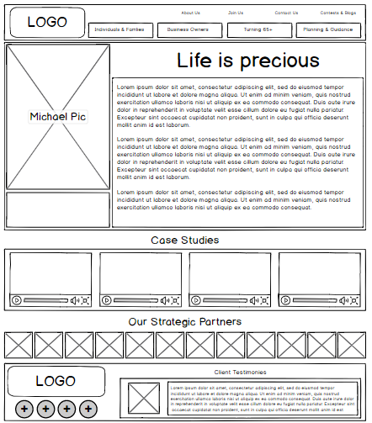

Slide 4

Speak to a Professional
Business Owners
Turning 65+
Planning & Guidance
Video of what it’s like working with our brokerage
Individuals & Families
Better Insure It was created with your peace of mind at the heart center of our operations. Many of our brokers are also clients because we know the value of our plans, how they work and have seen them in action. Not every plan or carrier is created equal. Each carrier has ratings, Annual Claims Paid reports, stock performance, reputation and several other indicators we look at before deciding to appoint with a company.
We are a permanent solutions brokerage and will be here for generations to come. Schedule an appointment with a broker today. We’ll meet you right where you’re at in life and be there every step of the way with you.
Speak to a Professional
Life Insurance
Vision Insurance
Dental Insurance
Health Insurance
Deductible Insurance
Disability Insurance
What is Better Insure It?
Who is their ideal client?
How do I know if I qualify for their plans?
How much do they cost?
What if I am on a tight budget?
What do your plans cover?
How can I learn more?
Mortgage Protection
Accident only policies
Critical Illness policies
Cancer, Heart & Stroke policies
Client Testimony on Customer Service
Options are a good thing! At Better Insure It, we serve people and not profits. We have a plan for everybody and budget. Whether you need a plan to get you through the next few months, this year or to retirement our brokers will work with you to understand exactly what your looking and willing to pay for it. There are no obligations or hassle involved. If we can help you, we are honored and will do our very best always. If we cannot, no hard feeling. Often, we can place you into the hands of one of our trusted referral partners for help.
Michael Gonzales, Owner
Air Force Veteran
Schedule an Appointment

Slide 5
Life Insurance
LIFE INSURANCE PICTURE
FAMILY
LOVED ONES
Life Insurance! Use it while you’re still alive if you need to!
Individuals & Families
All our policies come with a Living Benefits Rider that allows you to accelerate a portion of your death benefit while you're still alive if you receive a first-time diagnosis of one of sixteen critical illnesses.
Speak to a Professional
Life Insurance
Vision Insurance
Dental Insurance
What is Life Insurance?
Permanent
Term
Who buys Life Insurance?
Individuals
Families
Business Owners
Business Partners
How do I know if I qualify for Life Insurance?
What does Life Insurance Cover?
How much does it cost?
How does it work?
How do I learn more or sign up?
Health Insurance
Deductible Insurance
Disability Insurance
Mortgage Protection
Schedule an Appointment
Accident only policies
Critical Illness policies
Cancer, Heart & Stroke policies
Client Testimony on
Value of Life Insurance
Our Preferred Life Carrier Partners
LOGO
LOGO
LOGO
LOGO
LOGO
LOGO
LOGO
LOGO
LOGO
LOGO
LOGO
LOGO

